Slide 1
What Happened in Cuba, as Told by Twitter
Maira Asmat

Slide 2
Background Information
On July 11, protests erupted in Cuba due to the government’s authoritarianism and lack of reform.
The 60+ year US embargo against Cuba has also been named a source of economic tension.
Many demonstrators were reportedly detained by the government, and some concessions were also made.

Slide 3
Dataset
Made from 7/14 to 7/20
4000 Tweets used
Collected info such as followers and screen name
Tweepy API used

Slide 4
Methodology
Acquire Data
Preprocessing
Sentiment Analysis
Topic Modeling w/ BerTopic
VENUS
SATUR
JUPITE

Slide 5
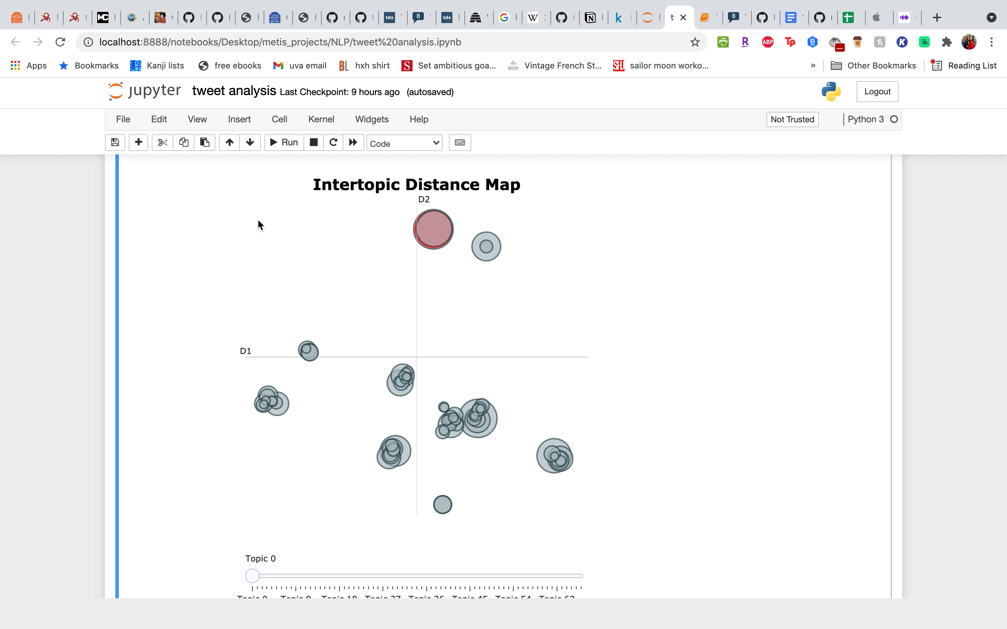

Slide 6
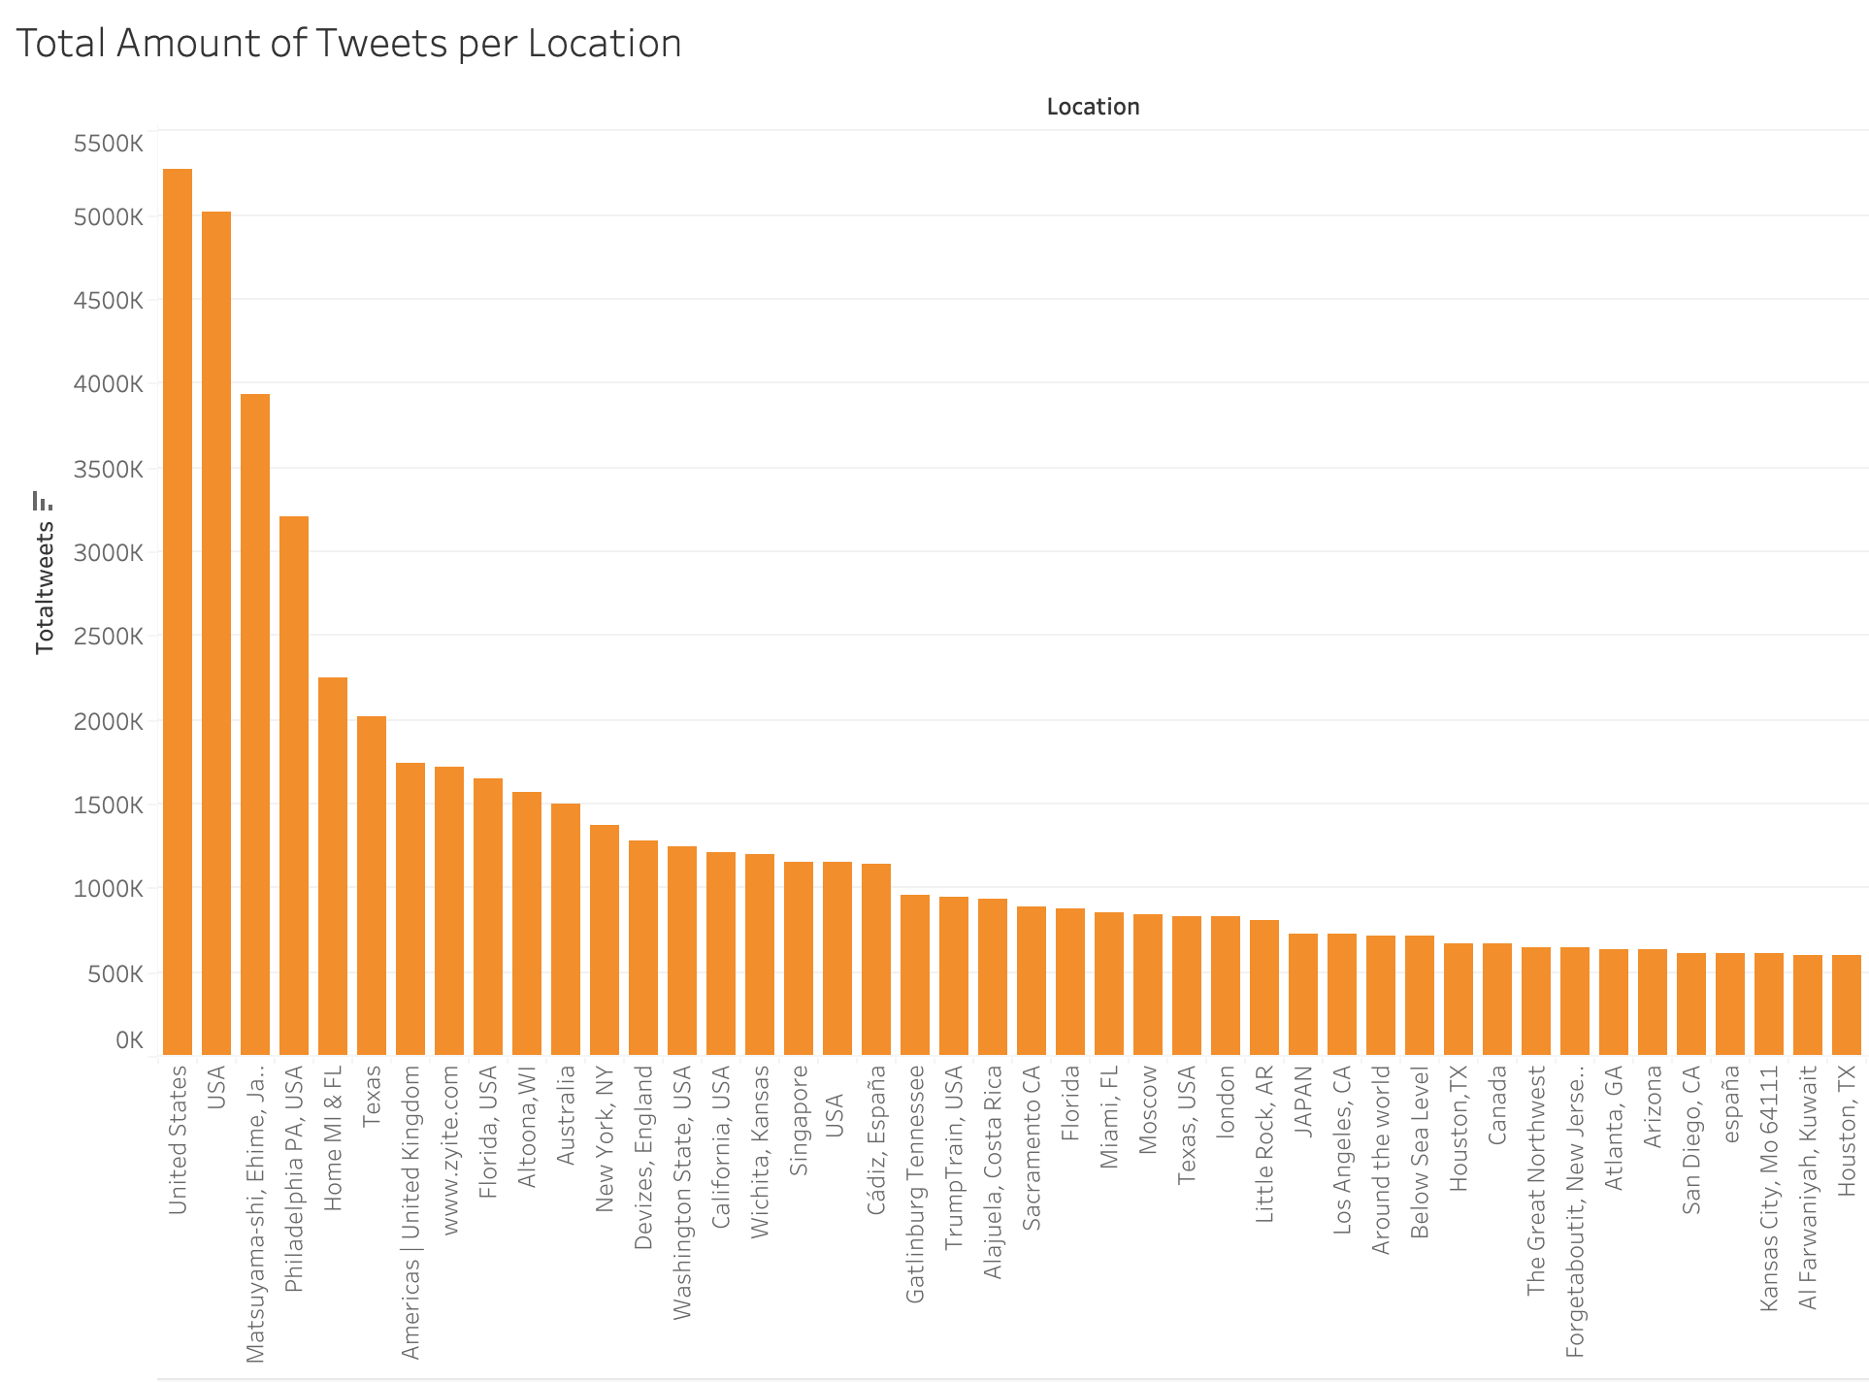

Slide 7
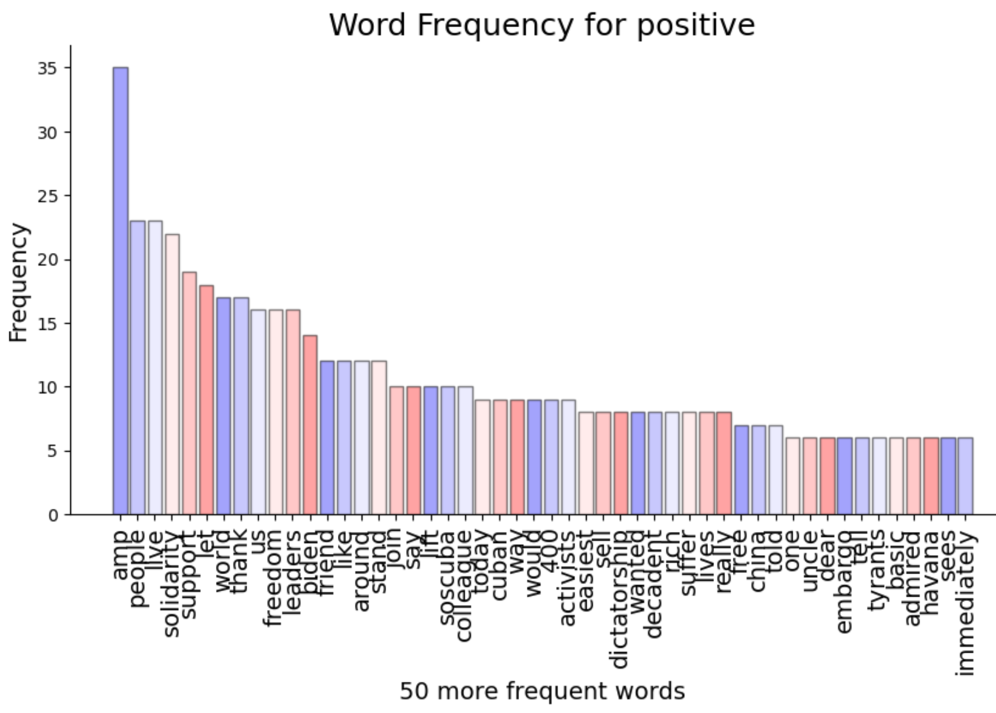

Slide 8
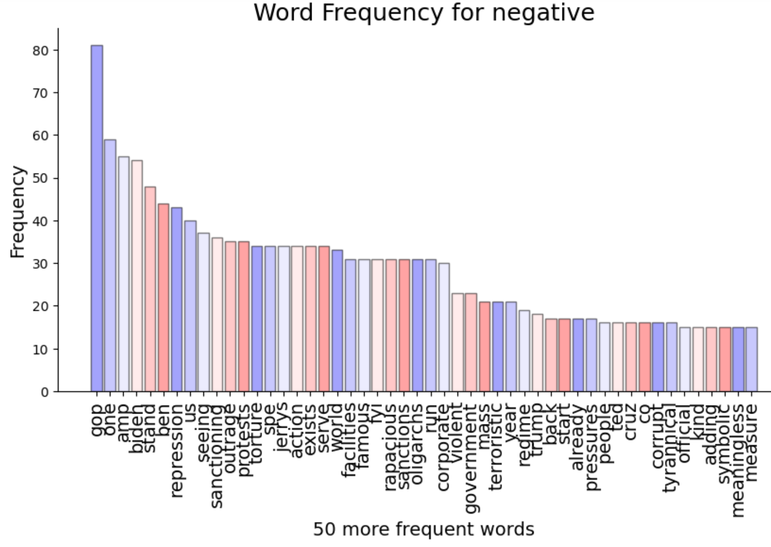

Slide 9
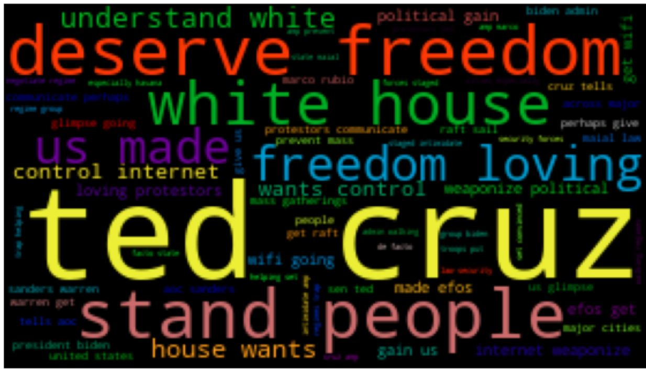

Slide 11
CAPITAL OF CUBA
Venus has a beautiful name and is the second planet from the Sun. It’s terribly hot and its atmosphere is extremely poisonous
HAVANA

Slide 12
Bi-gram WordCloud for All Tweets
THE CAPITAL
Mercury is the closest planet to the Sun and the smallest one in the Solar System

Slide 13
Map of Cuba Infographics
SATURN
MERCURY
Yes, this is the ringed one. It’s a gas giant
Mercury is the closest planet to the Sun
JUPITER
VENUS
It’s the biggest planet in the Solar System
Venus has a beautiful name, but is very hot
NEPTUNE
MARS
Neptune is the farthest planet from the Sun
Despite being red, Mars is a cold place

Slide 14
Map of Cuba Infographics
MARS
Despite being red, Mars is a cold place. The planet is full of iron oxide dust
JUPITER
Jupiter is a gas giant and the biggest planet in the Solar System
SATURN
TYPICAL CUBAN DELIGHTS
Saturn is the ringed one. It’s composed mostly of hydrogen and helium
Despite being red, Mars is actually a cold place. It is full of iron oxide, which gives the planet its reddish cast

Slide 15
Map of Cuba Infographics
Mercury is the closest planet to the Sun
Neptune is the farthest planet from the Sun
CUBA
Venus has a beautiful name, but is hot
Despite being red, Mars is a cold place

Slide 16
Map of Cuba Infographics
TRANSPORTATION
Despite being red, Mars is actually a cold place
2
MARS
Mercury is the closest planet to the Sun and the smallest one in the Solar System
NEPTUNE
1
Saturn is composed mostly of hydrogen and helium

Slide 17
Map of Cuba Infographics
CLIMATE
Mercury is the smallest planet
ECONOMY
Venus has a beautiful name
TOURISM
Despite being red, Mars is a cold place
POPULATION
Yes, this is the ringed one

Slide 18
Map of Cuba Infographics
JUPITER
Jupiter is the biggest planet
MERCURY
Mercury is the smallest planet
VENUS
CUBA
Venus has a beautiful name
MARS
Mars is a very cold place

Slide 19
Map of Cuba Infographics
NEPTUNE
MARS
Neptune is the farthest planet
Mars is a very cold place
MERCURY
VENUS
Mercury is the smallest planet
Venus has a beautiful name

Slide 20
Map of Cuba Infographics
Lighthouse of the Castillo de los Tres Reyes del Morro
The Sun is the star at the center of the Solar System
NEPTUNE
HAVANA
Jupiter is the biggest planet in the Solar System
Mercury is the closest planet to the Sun and the smallest one in the entire Solar System
JUPITER
Venus has a beautiful name, but is terribly hot
VENUS
HAVANA, CUBA

Slide 21
Map of Cuba Infographics
JUPITER
SANCTI SPIRITUS, CUBA
Jupiter is a gas giant and the biggest planet in the Solar System. It’s the fourth-brightest object in the sky
Despite being red, Mars is a cold place. It’s full of iron oxide dust, which gives the planet its reddish cast
MERCURY
Mercury is the closest planet to the Sun and the smallest one in the Solar System
VENUS
SANCTI SPIRITUS
Venus has a beautiful name and is the second planet from the Sun. It’s terribly hot

